Slide 1

Year 8 Mathematics Investigation
-The Cartesian Plane and Pythagorean Triples

Slide 2
1.1
-Create and explain a reusable means of translations

Slide 3
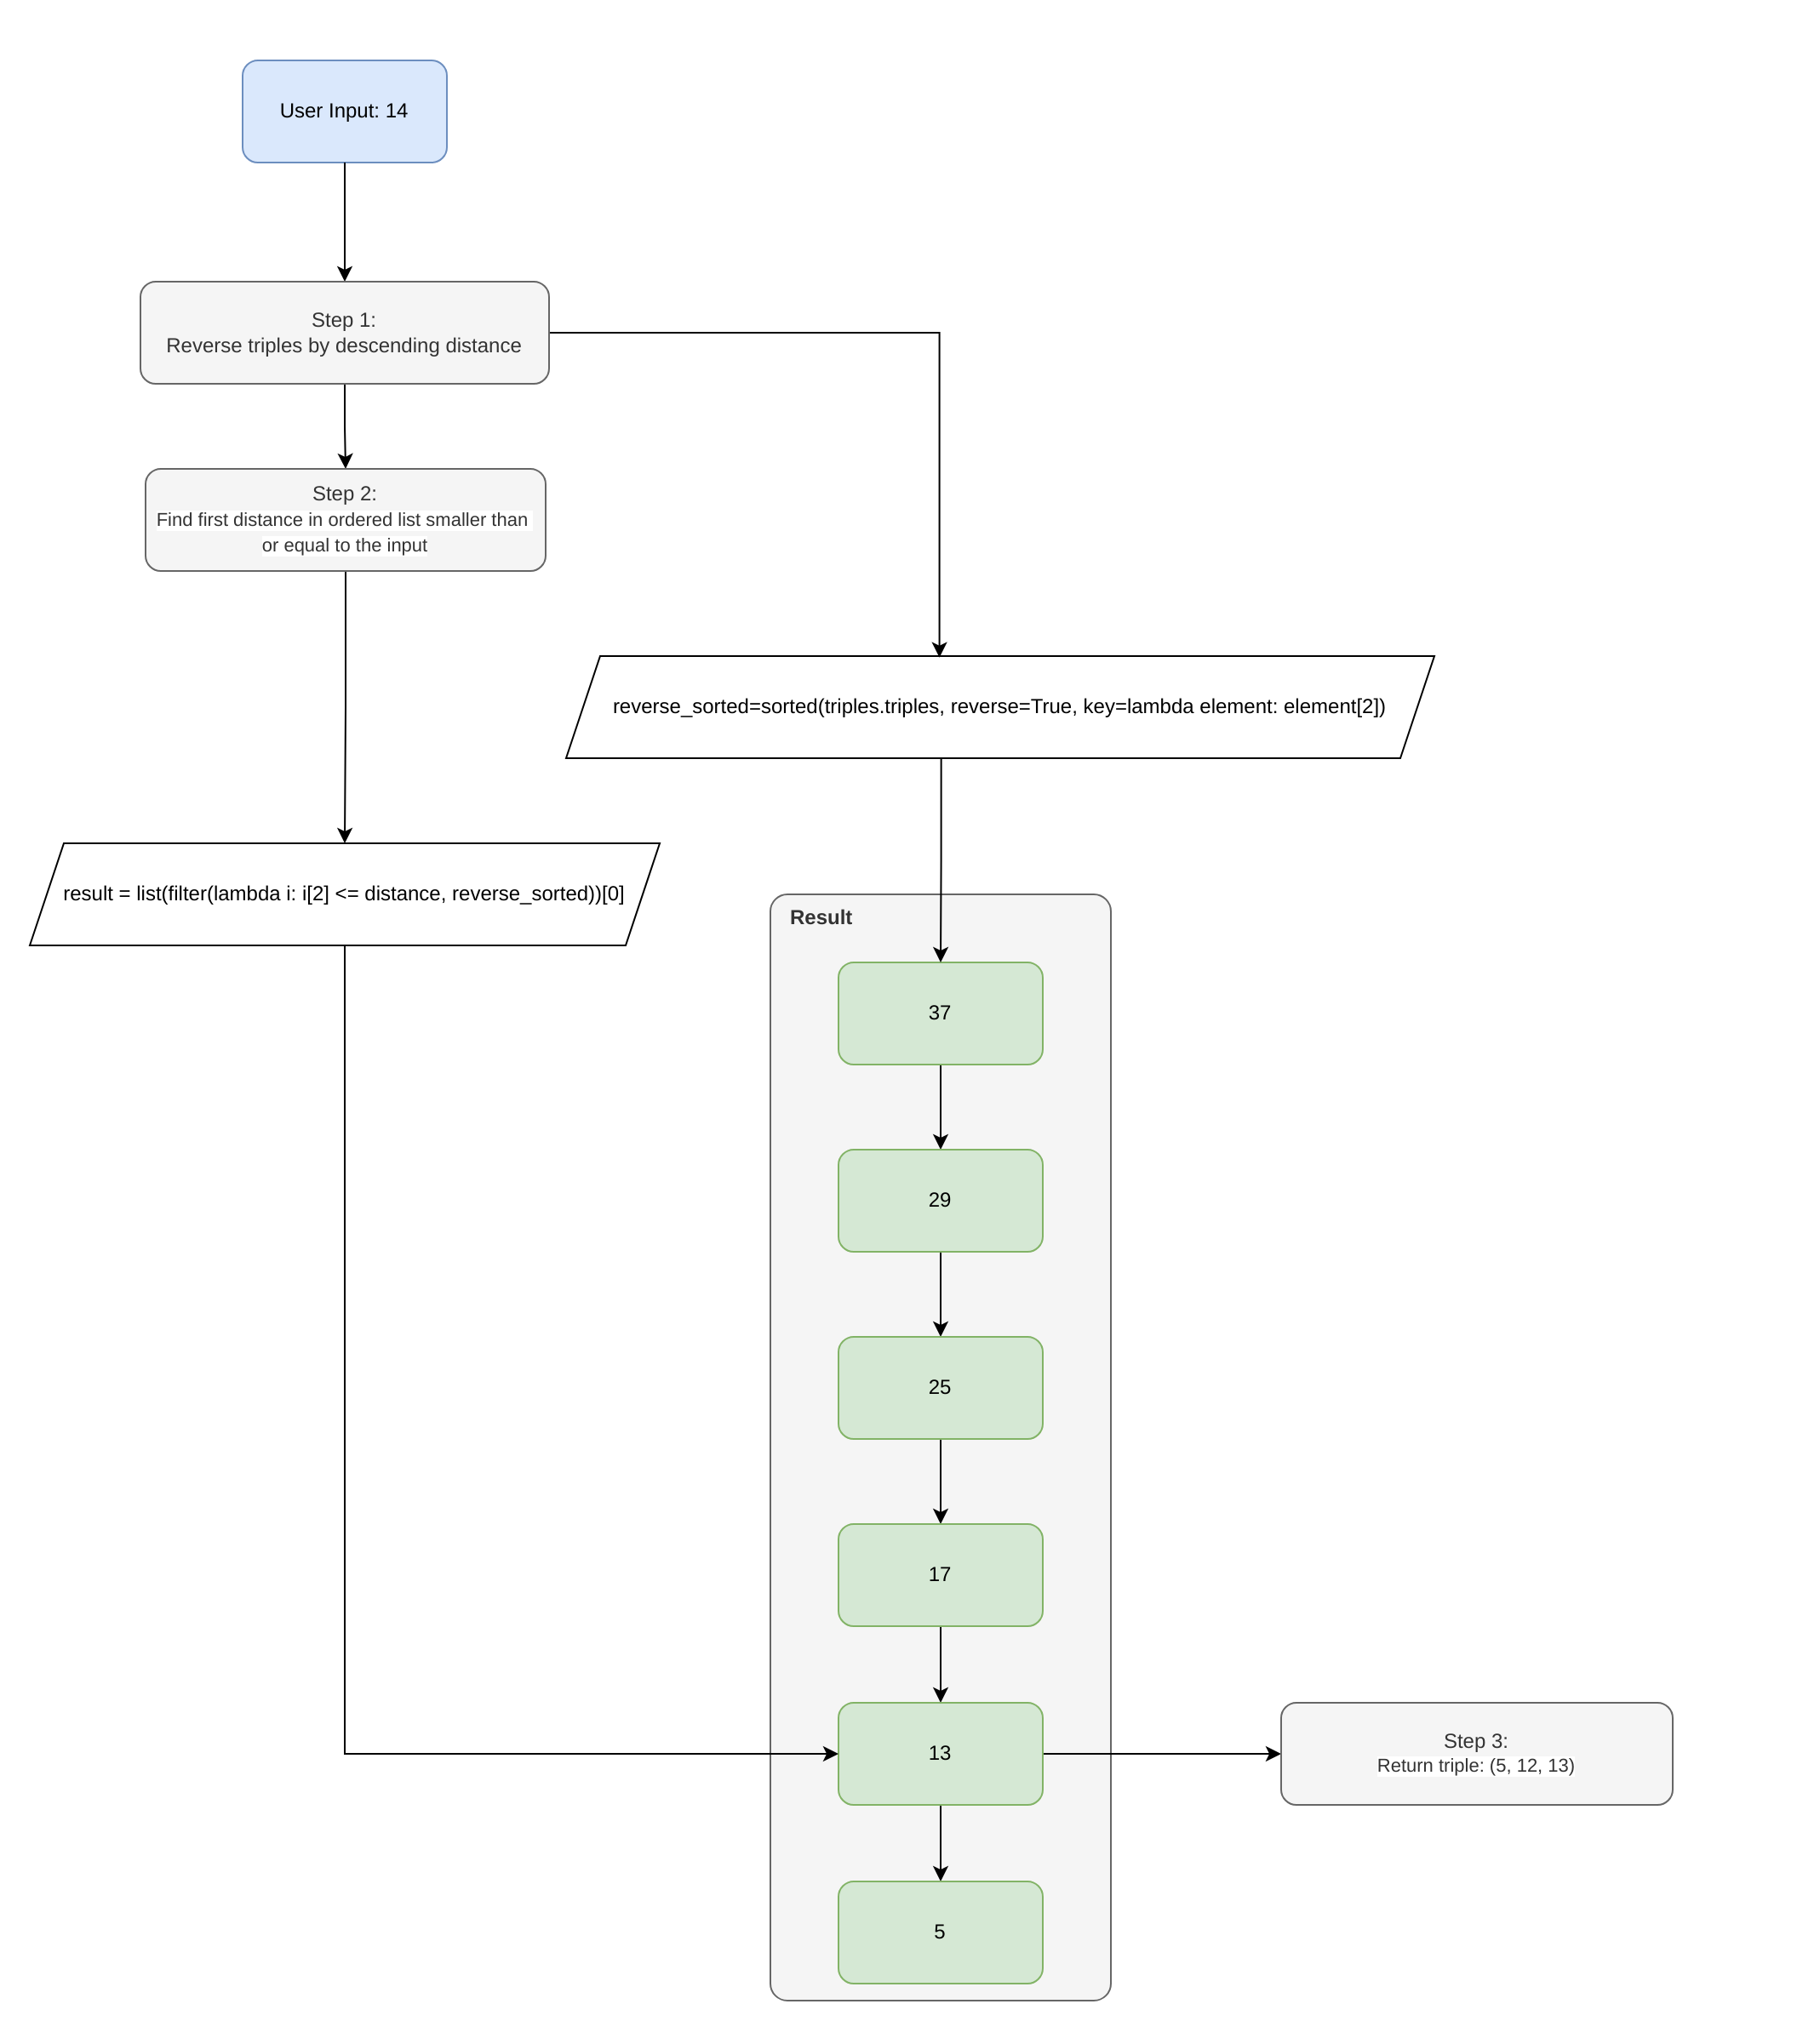
When a user inputs a number, say 14 for instance, the code sorts the list of triples in descending order according to their distance. It then finds the first distance in the ordered list that is smaller than or equal to the user input, which would be 13 in this case. Finally, the code returns the triple with the hypotenuse equal to that distance, which would be (5, 12, 13).

Slide 4
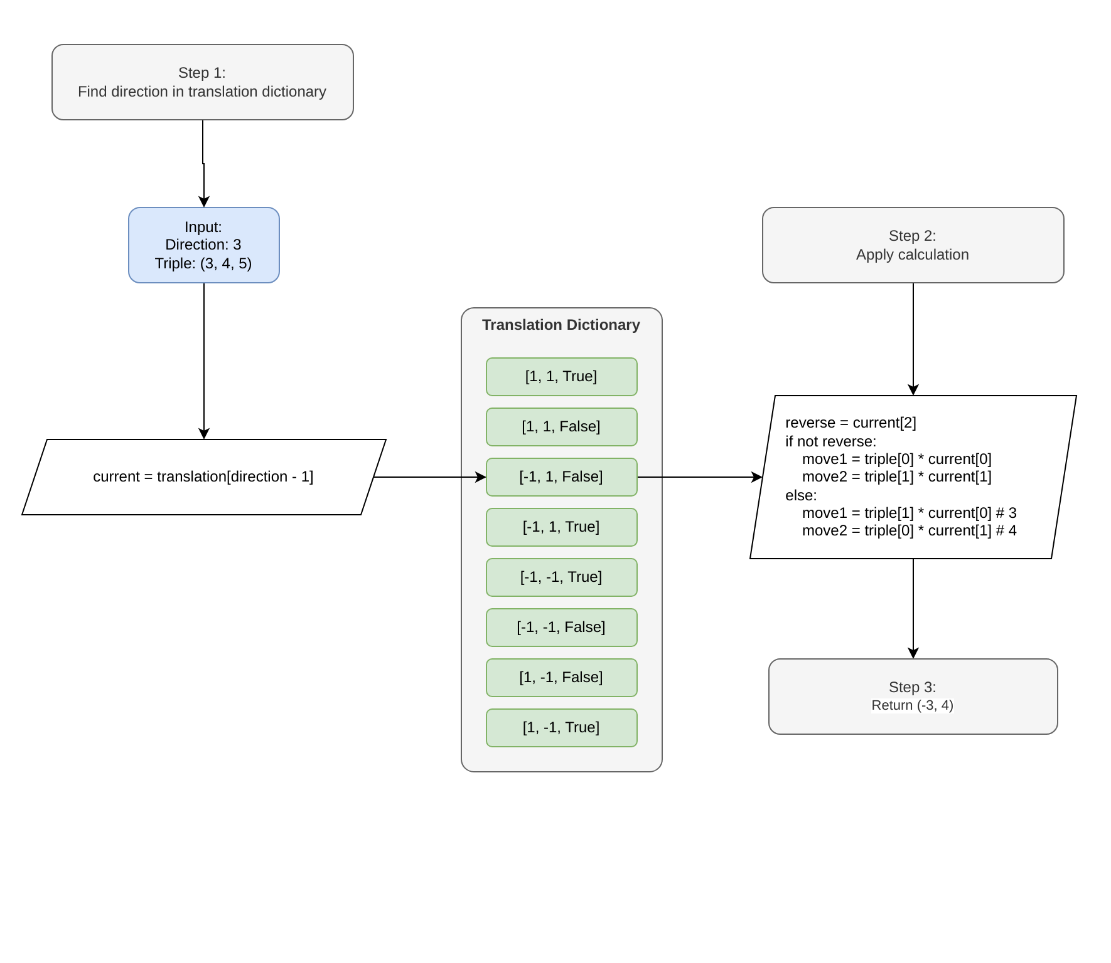
To convert a triple into the appropriate values for movement, I use the following code. For example, if the user inputs a direction of 3 and a triple of (3, 4, 5), the code will search for the option in the list with the index matching the direction. It will then perform the necessary calculations and return the result. Using the given example, the code will return (3, -4).

Slide 5
1.2
-Use functions, validate input and document imports

Slide 6
Validation
The code will verify if the distance and direction inputs are integers.
It will also check if the distance is a positive value and if the direction is between 1 and 8 or not.
If any of these tests fail, it will return an error message that explains the reason for the failure and instructs the user to try again.

Slide 7
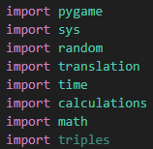
Imports
Pygame – Creates game window and UI
Random – Generates random values for coordinates and random movement
Sys- Exits when requested
Time – Used for time delays
Triples List – List of the first 127 primitive Pythagorean triples
Translation File – Contains the functions for my translation method
Calculations File – Contains the functions for calculating Distance, Midpoint and Gradient

Slide 8
Part 1
-create and place entities

Slide 9
2.1
-Represent the two players and the destination as dictionaries

Slide 10
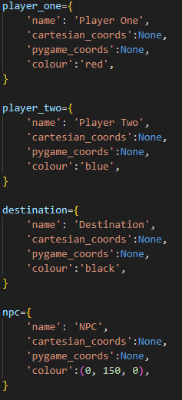
The players and destination info are held in dictionaries.
The dictionaries hold the cartesian coordinates, pygame coordinates, and color

Slide 11
2.2
-Randomly place the players and the destination

Slide 12
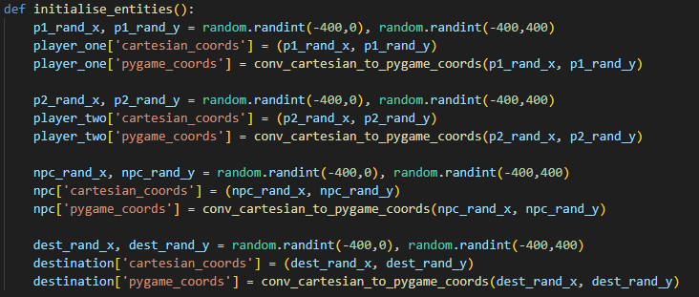
Entities are randomly placed using Randint from the random module.
Random values between -400 and 400 are picked for the x and y coordinates for all entities.

Slide 13
2.3
-Calculate distance, midpoint and gradient

Slide 14
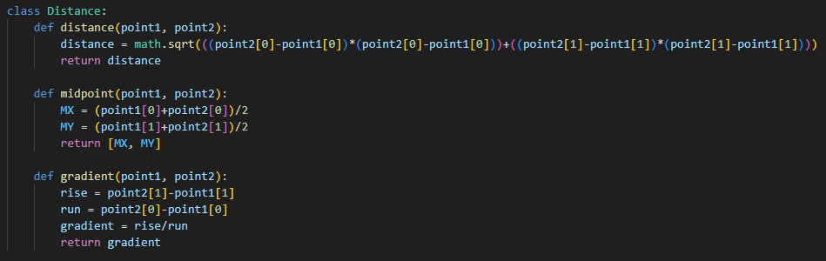
Distance = √((x2-x1)^2)+((y2-y1)^2)
Midpoint = (x, y) = ((x1+x2)/2), ((y1+y2)/2)
Gradient = (y2/y1)/(x2-x1)

Slide 15
2.4
-display information about players and the destination

Slide 16
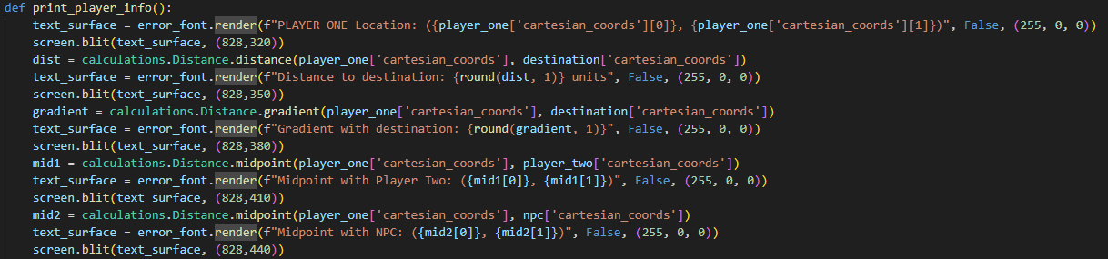
Whenever the print_player_info() function is called, it will print the info of the corresponding player:
The Location of the player
The Distance from the player to the destination
The Gradient from the player to the destination
The Midpoint with the other Player
The Midpoint with the NPC

Slide 17
Part ii
-taking turns moving players

Slide 18
3.1
-use personal space buffer to identify a winner

Slide 19

Win condition decided by personal space buffer
All the entities have a buffer zone of radius 10 units
A win is found using distance if a player is in the buffer zone of another entity, their distance will be less than or equal to 10 units
If the distance is found to be 10 or fewer units then the player who made the move will win

Slide 20
3.2
-move players along the hypotenuse of a right-angled triangle

Slide 21
Moving along hypotenuse
Players will enter the distance and direction of the movement they want
The triple list is used to match the distance to a hypotenuse (explained in 1.1, translations)
The movement is then translated using the two matching shorter sides to the hypotenuse
The two sides are matched to the x and y coordinates based on the given direction of movement (also explained in 1.1, translations)

Slide 22
Part iii
-advanced features

Slide 23
4.1
-introduce a time penalty

Slide 24
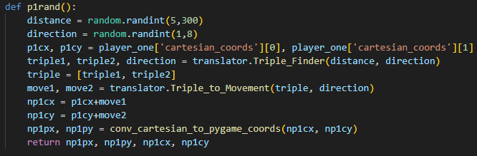
Time Penalty
At the start of a player's turn,
A 10-second timer will begin counting down.
The player must input their movement within this time.
If they fail to do so,
the code will then make them move a random distance in a random direction.

Slide 25
4.2
-design and implement player three as an npc

Slide 26
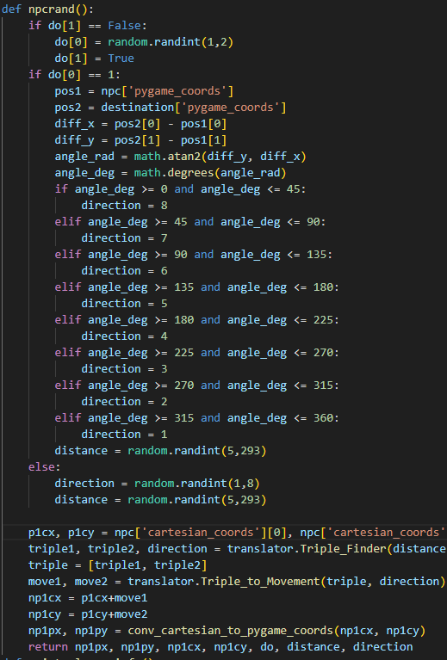
NPC
When it's the NPC's turn, it will randomly choose between True or False.
If False is chosen, the NPC will move a random distance in a random direction.
If True is chosen, the NPC will calculate the direction of the destination from its current position using things such as the gradient and position of the destination.
Subsequently, the NPC will move a random distance between 5 and 500 units in that direction.

Slide 27
4.3
-visual depiction of gameplay

Slide 28
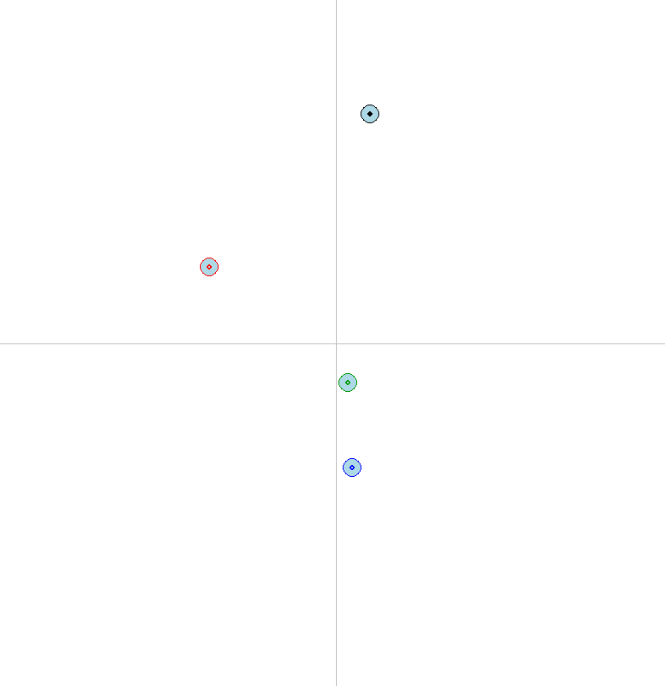
Visual representation
Pygame is utilized to create an 800 x 800 Cartesian plane.
Functions are created to load the plane, players, and destination.
There are also functions to convert Cartesian coordinates to Pygame coordinates and to refresh the game window.
The personal buffer is also displayed as a circle of radius 10 around the entities

Slide 29
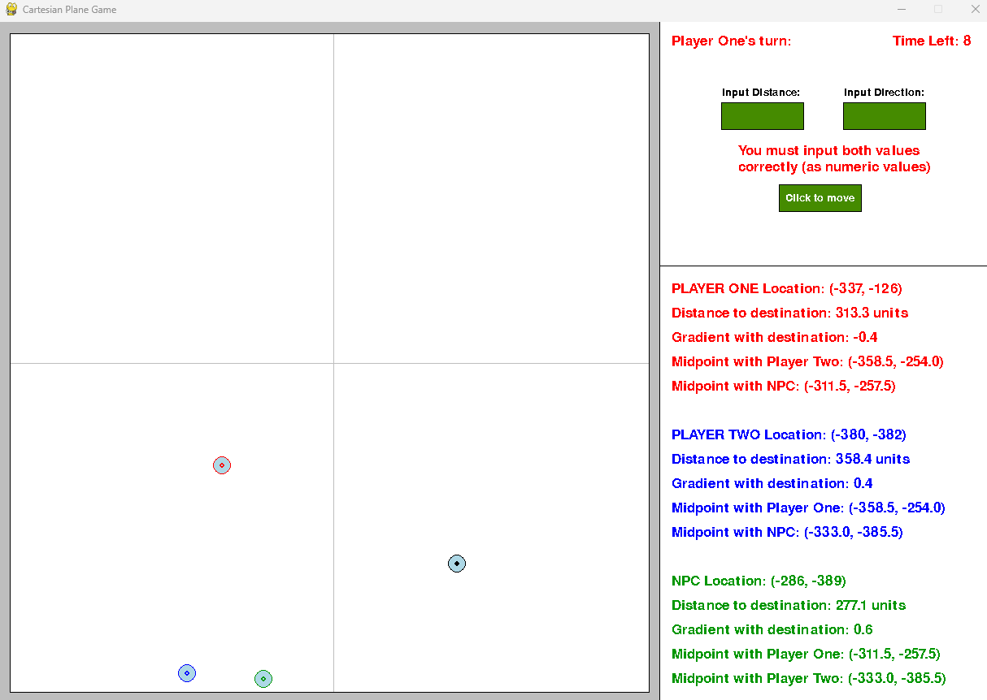
UI (User interface)
There will be a game UI in the window, next to the Cartesian plane.
It will have input text boxes for inputting the distance and direction,
as well as a button for accepting the movement.
The window will also always display player information (as explained in 2.4 - display information about players and the destination).
The UI displays which player’s turn it is and the amount of time left in their turn

